Slide 1



MULTIMEDIA and COMMUNICATIONS
Computer Science CS1033a/b
Lecture #11
Intro to Sound
Instructors:
Laura Reid (section 001)
Vivi Tryphonopoulos (section 002)

Slide 2
Lecture Topics
Exploring Sound
  Intro to Sound
  What is Digital Format
  Sources of Sound
  Sound Editing Software
  Sound File Formats
  Audio cycle
  Sound on the web
  Streaming

Slide 3
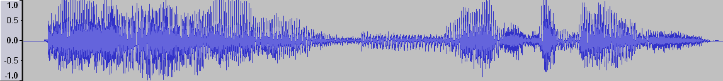
Intro to Sound
We rely on SOUND to enhance Multimedia Applications
WHY?
Easily capture the attention of users
Facilitate easy learning
Set the mood
Sound incorporated into Video, Animation production
http://www.a1freesoundeffects.com/cartoon.html

Slide 4
Intro to Sound
Sound can:
  Set a mood → http://www.mustangdrive-in.com/
  Sell, Sell, Sell → http://www.csd.uwo.ca/~lreid/cs033/sound/awardwinningpoo.wav
  Educate/Present Information → http://www.cbc.ca/radio/
  Allow communication over the web via Internet

Slide 5
Where can you get sound?
Avoid copyright infringement when incorporating music on your website.
  Purchase a cd → must watch for copyright infringements when using sound on your site
    http://www.csd.uwo.ca/~lreid/cs1033/sound/captureusingaudio.wmv
  Download sound from companies → e.g. http://www.istockphoto.com/index.php
  (search for background music, then cow mooing)
  http://www.a1freesoundeffects.com/cartoon.html
  Download from iTunes

Slide 6

Where can you get sound?
Create your own sound:
  Recording program with a computer's operating system (such as Sound Recorder) and speak into a microphone attached to the computer – quality will not be the best
  Recording studio with equipment that record sounds digitally. Produces a high quality commercial product
  Electronic instruments such as synthesizers can be used to create music sound files. Connecting the instrument to a computer allows the sounds to be captured in a MIDI (Musical Instrument Digital Interface) format.

Slide 7
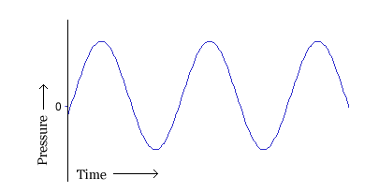
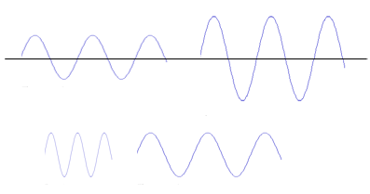
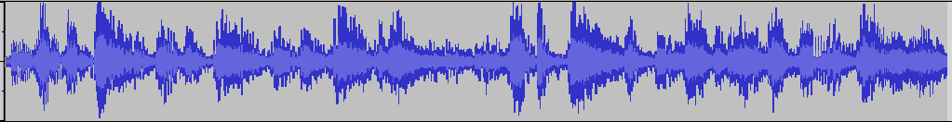
What is Sound?
Sounds are pressure waves of air
  http://videos.howstuffworks.com/discovery/27959-assignment-discovery-wavelength-basics-video.htm
Visualize the sounds as a series of
recurring waves called a waveform.
Volume - the higher the wave the
louder the sound
Pitch or frequency
- the closer together the waves
the higher the pitch
http://library.thinkquest.org/19537/
Play audio clip
Bells
Oh

Slide 8
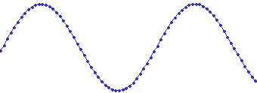
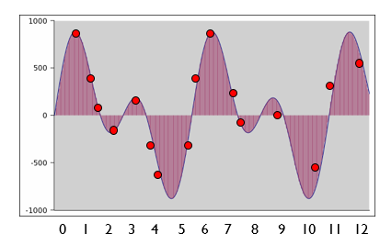
How do computers Represent Sound?
In a multimedia application sound must be
in a digital form (string of 1s and 0s).
Each dot in the figure represents one audio sample
To convert analog sounds to digital sounds
→ thousands of samples are taken of the sound waves and recorded as bits.
What’s wrong with this type of sampling?

Slide 9
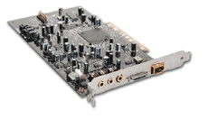
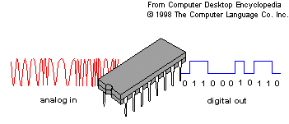
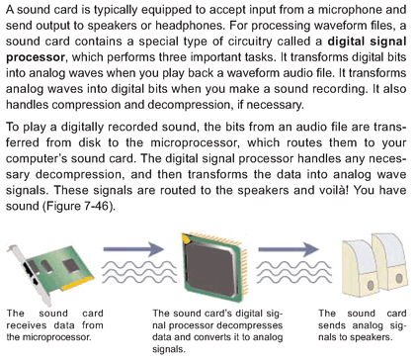
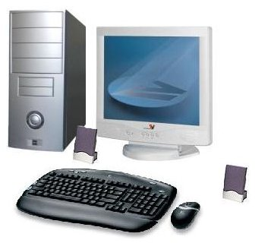
How is Sound Recorded?
Computers have a sound card which converts the the sound wave from a microphone (analog to digital)
Laptops rarely have a sound card because manufacturers incorporate sound circuitry into system board
Sound card has:
  (ADC) Analog-to-Digital Converter for recording
  (DAC) Digital-to-Analog Converter for playing audio
Operating system (Windows, Mac OS X, Linux, etc.) talks to the sound card to actually handle the recording and playback

Slide 10
QUALITY OF DIGITAL RECORDING
Quality of Sound is dependent on the following criteria.
Sample Rate
Sample Size
Channels
Codecs

Slide 11
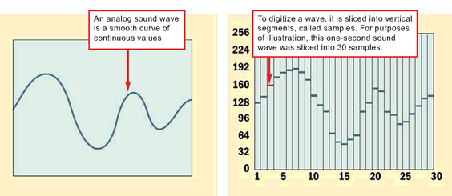
QUALITY OF DIGITAL RECORDING
SAMPLE RATE
  # of samples taken in a second
  Number of times/sec that the waveform is measured
  1000 samples per second = 1 KHz (1000Hz)
1 sec
1 sec

Slide 12
QUALITY OF DIGITAL RECORDING
SAMPLE RATE
Reminder:
Number of times/sec that waveform is measured
1000 samples per second = 1000Hz = 1 KHz
We MUST take 2 or more samples per wave
(known as Nyquist Limit)
Question: What is the advantage of taking lots of samples per wave
→ (better sound)
Question: What is the disadvantage of taking lots of samples per wave
→(bigger audio file)

Slide 13
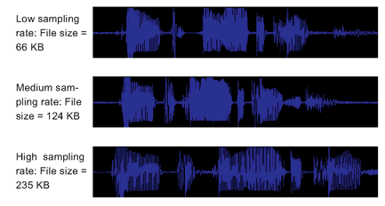
QUALITY OF DIGITAL RECORDING
SAMPLE RATE
Number of times/sec that waveform is measured
1000 samples/sec
= 1000Hz
= 1 KHz
8 KHz VOICE ONLY (telephone quality)
11.025 KHz AM Quality
22 KHz FM Quality
44.1 KHz CD

Slide 14
Can you hear the difference?
One of these was sampled at 8000Hz (8KHz) and one at 16000Hz (16KHz).
Question: Which one should sound better?
Question: Which one does sound better?
  One
  Two

Slide 15
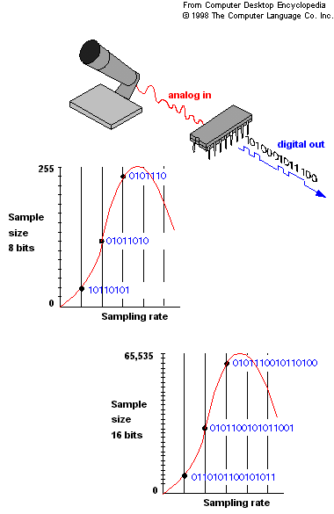
QUALITY OF DIGITAL RECORDING
- SAMPLE SIZE
SAMPLE SIZE (aka bit depth)
  Each measurement taken is represented by a value
  How many bits do we use represent that value?
  →The higher the sample size – better sound, bigger file

Slide 16
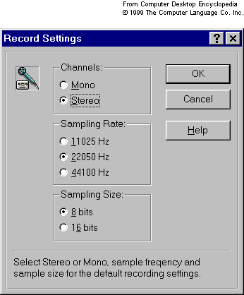
QUALITY OF DIGITAL RECORDING
- CHANNELS -
(3) CHANNELS
Mono signal
      one channel ( stream) of data reproduced equally on both speaker channels
Stereo signal
      consists of two channels (streams)of data
      double the size of mono file, but higher quality

Slide 17
QUALITY OF DIGITAL RECORDING
- CODECS
(4) CODECS
Software programs that greatly reduce the audio file size
Codecs for audio use lossy compression
  Removes redundant and less-significant data
  Each time compression applied, quality of level of the file diminishes
  See file formats section for compression use (.mp3, .ra )
Common File Formats that are uncompressed:
  .wav (very common, 44KHz, 16bit)
  .aiff
  .cdda (Red Book) → standard for CDs, 44KHz, 16 bit per sample, 2 channels.

Slide 18
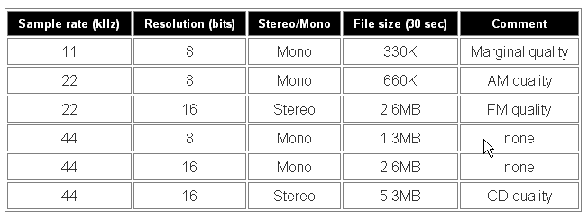
QUALITY OF DIGITAL RECORDING
SUMMARY
Combine → Sample Rate… Size Size….Channel
Higher sampling rate & higher sample size, the more accurately sound can be digitized.
Quality of the digitized sound gets better
1 KHZ = 1000 cycles per second

Slide 19
QUALITY OF DIGITAL RECORDING
In Audacity,
Settings are in
Edit >Preferences

Slide 20
How big can audio get?
An example of uncompressed sound with CD quality for 1 minute of audio:
  1 minute of recording → 60 seconds
  60 * 44,100 samples/second → 2,646,000 samples
  2,646,000 samples * 16bits per sample → 42,336,000 bits
  42,336,000 bits * 2 (stereo, 2 channels) → 84,672,000 bits
  84,672,000 bits / (8bits per byte) → 10,884,100 → About 10 MB (Megabytes)!!!

Slide 21
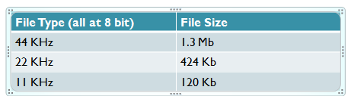
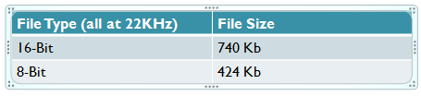
Sound Compression Strategies
Reduce the number of samples (sample rate)
    Go from 44KHz to 22KHz (this will affect the quality)
Reduce the bit depth (sample size)
    Go from 16 bit to 8 bit (this will affect the quality)
Reduce the channels
  Changing from stereo to mono will ½ the size of the file
Compress using the appropriate codec

Slide 22
Sound-Editing Software
Sound editing programs have the following features:
Record sounds in different sample sizes and resolutions
  Rearrange the Waveform
      Cut, copy, drag, trim parts of the waveform
      Overlap two or more pieces of audio
      Find words you want to edit out and cut them from the wave form.
  Modify the Volume
      Use amplify, fade-in, fade-out, envelope, normalize
      Sometimes songs from some CDs playing much louder than others, even at the same volume setting. Normalization corrects this by scanning audio files to find peak or average level and proportionally increasing or reducing the levels to obtain the desired volume level. http://www.hometracked.com/2008/04/20/10-myths-about-normalization/ (go to myth 2, snare drum vs. entire clip)

Slide 23
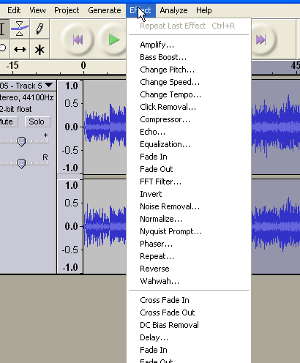
Sound-Editing Software
Noise Reduction
  Hiss Reduction → noise within a given frequency range
  Noise Reduction/Removal → software examines the audio and finds unusual differences from waveform and removes them. Need a longer piece of audio than for Hiss Reduction because software had to analyze the audio to generate stats on what is unusual. http://www.alpinesoft.co.uk/vinylstudio/samples.aspx (go to Hiss Example 4)
Special Effects
  Adding echo, changing the pitch of a portion
Downsample and reduce the bit depth→i.e. compress, WHY COMPRESS?

Slide 24
Audio File Formats
Using audio on the Web?
Audio files are quite large
Consider using the right file format!
File Formats have different characteristics
    Platform Support
    Browser Support
    Compressed or Uncompressed quality
    Which file format should you use? See next slide

Slide 25
Audio File Formats
Audio Format | File Extension | Advantages | Disadvantages
Advanced Audio Compression | .aac | Good sound quality Used on iTunes | Copy protected Limited to approved devices
Audio Interchange Format | .aif /.aiff | Excellent sound quality Supported without a plug-in | Uncompressed so large files
MP3 | .mp3 | Good sound quality even though compressed Can be streamed over the Web | Requires standalone player or browser plug-in
Real Audio | .ra, .rx | High Compression Very small files Can be streamed over the web | Sound quality not great Requires a player or plug-in
Wave | .wav | Good sound quality Supported without a plug-in | Uncompressed, very large files
Windows Media Audio | .wma | Good sound quality even though compressed Used on music download sites | Files can be copy protected Requires Windows Media Player 9 or higher

Slide 26
Audio Compression
File Formats that use lossless codecs/compression:
  There are a few but not very common
Common File Formats that are uncompressed:
  .wav (very common, 44KHz, 16bit)
  .aiff
  CDDA(Compact Disc Digital Audio defined in the Red Book which contains audio standards) → standard for CDs, 44KHz, 16 bit per sample, 2 channels.
    Thus 1 second of music must be played at a bit rate of:
    44100*16*2*1=1,411,200 bits per second = 1411.2Kbits per second
    Compare with: mp3 →128Kbits per second is most common, makes it good for the Internet!

Slide 27
Audio Compression
NOTE: .wma and .mp4 are lossy AND allow for built-in lockdowns which is why Microsoft and Apple are pushing them ;-)
If you put sound into your Flash animation you will never have to worry about the sound not playing because every computer comes with a Flash Player ☺ (no need to download a plugin)

Slide 28
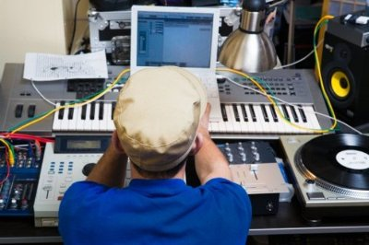
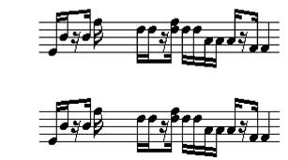
http://entertainment.howstuffworks.com/midi2.htm
Connecting keyboard to computer and storing notes in midi format
What is MIDI Music?
What is MIDI music?
Musical Instrument Digital Interface
  Classified as synthesized sound
  MIDI deals with music and synthesized sound,
  It does NOT handle voices or noise well
  Contains instructions for creating the pitch, volume and duration of notes that sound like various musical instruments, the note being played, how hard it was played etc.
Sample One(midi)
Sample Two (mp3)

Slide 29
Sound File Formats
Disadvantages of MIDI Music:
Does not produce high-quality vocals
Advantage:
Midi files are more compact.
Small File sizes, easy to edit and change
3 min of Midi music = 10 KB
3 min in another uncompressed waveform = 15 MB
Sample One(midi)
Sample Two (mp3)

Slide 30
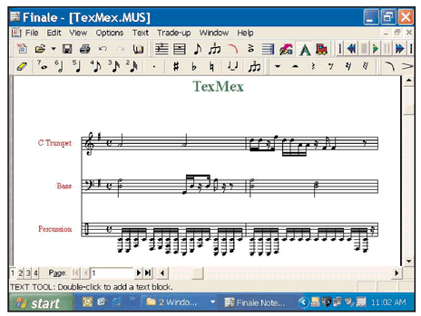
Sound File Formats –
MIDI FORMAT
Software such as Cakewalk, Cubase and Finale can be used to create and edit MIDI music.
Create your own tunes
Input directly from a MIDI instrument to your computer
Edit notes/combine parts for several instruments

Slide 31
Can you tell the difference
Which one is a live recording and which one is computer generated?
  One (midi)
  Two (mp3)

Slide 32
Audio can be streamed too!
Downloadable Audio |  | Streamed Audio
Advantages | Disadvantages | Advantages | Disadvantages
Once downloaded, can be replayed, edited over and over (don’t need to wait again for download) | Takes a long time to download, especially for big files | Plays immediately | Cant rewind, pause, etc.
Don’t need a special streaming web server to post the file | Takes up disk space on the computer to store it | Consumes RAM only while being played, then purged after | Need a special server to post it
Example: Audio Files on Limewire |  | Example: cbc radio

Slide 33
Posting Sound on the Web
(1) Linking to the Sound file
  Have a link to music that the user clicks on. Music will never start playing on the webpage until the user clicks on the link.
  <p>Download a <a href="dearmom.wav">sound file </a></p>
(2) Embed the sound file
  (a) Starts to play once user clicks on the “Play” button.
  <embed src="dearmom.wav" autostart=“false" width="144" height="50“ loop="1">
  (b) Starts to play as soon as the user comes to the webpage
  <embed src="dearmom.wav" autostart=“true" width="144" height="50" loop="1">

Slide 34
Let’s Review
Which has more samples per second?
  CD recording
  FM Radio
  Both are the same
In general, what is the minimum amount of samples needed for voice only?
Which part of a sound wave reflects the volume?
CD –
FM --
CD – 44KHZ
FM – 22 KHZ
Voice –
Voice – 8 KHZ

Slide 35
The end of lectures!!
And now for the Review and
Practice Questions
You have to attend to get this!

